Slide 1

Budget Overview
Fiscal Year 2025-26

Slide 2

FUND DEFINITIONS
GENERAL FUND
State tax revenue allocated to the University.
CASH FUNDS
Derived from tuition, fees, investment income, and other miscellaneous income.
FEDERAL FUNDS
Provided by federal agencies for research, grants and contracts, and student aid programs.
REVOLVING FUNDS
Self-generated from departmental sales, charges for housing, food services, etc.
TRUST FUNDS
State and private gifts, grants, and contracts, non-federal student aid programs, etc.

Slide 3
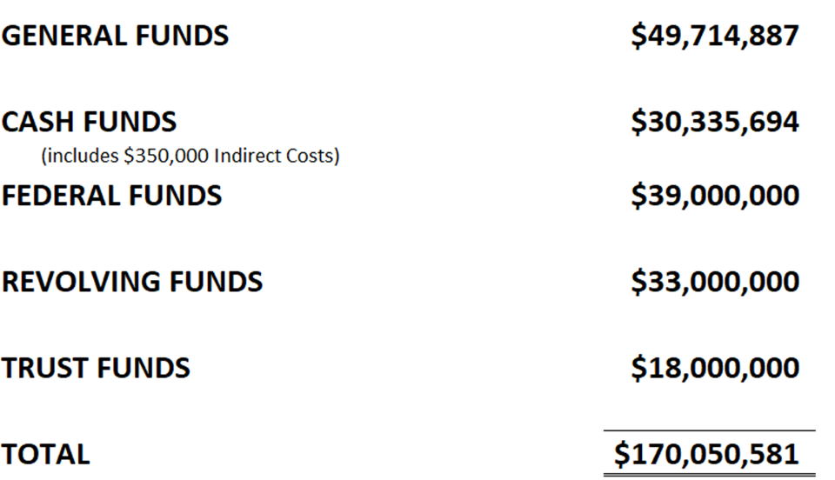
2025-26 Operating Budgets
Estimated Revenue by Fund Source

Slide 4
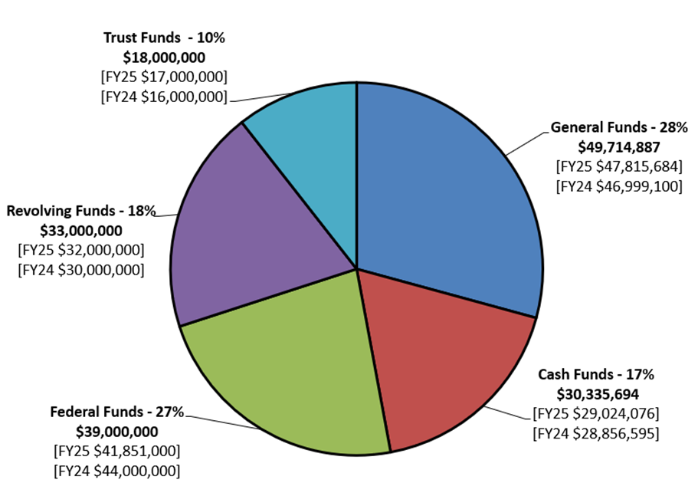
2025-26 Operating Budgets
Estimated Revenue by Fund Source

Slide 5
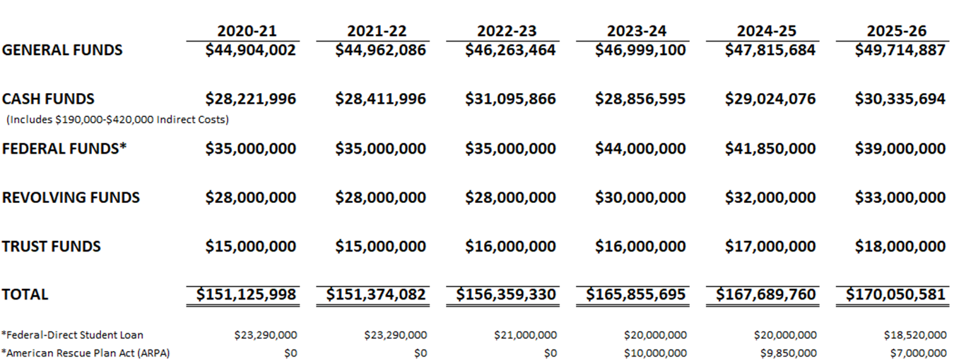
Historical Operating Budgets
Estimated Revenue by Fund Source

Slide 6
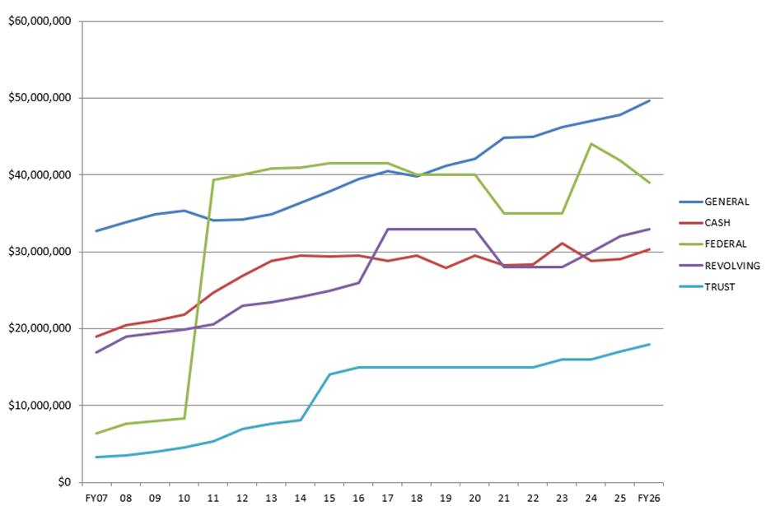
Historical Operating Budgets
Estimated Revenue by Fund Source

Slide 7
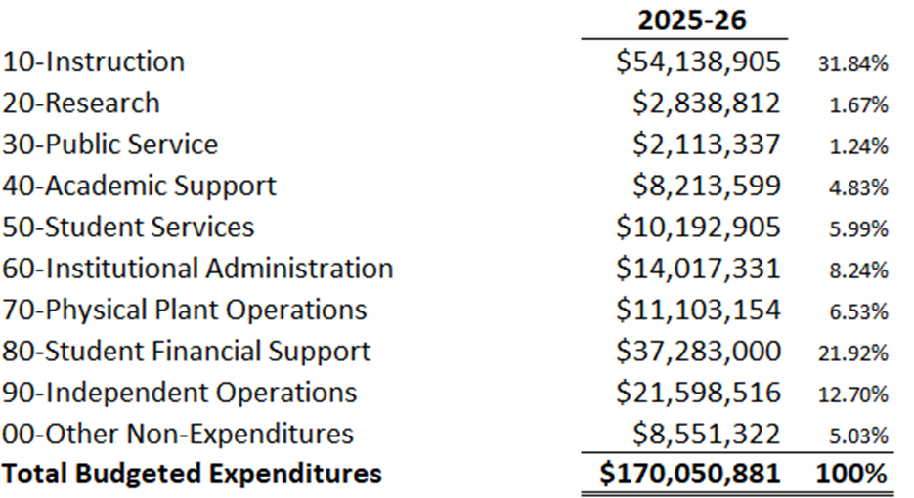
2025-26 Operating Budget
Budgeted Expenditures by Spending Category

Slide 8
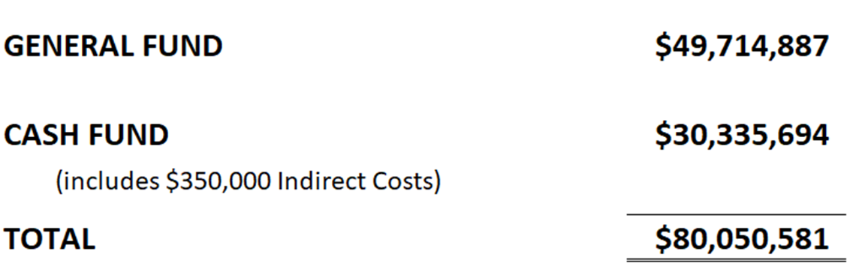
2025-26 State Aided Budget
State and University Generated-Unrestricted and Designated

Slide 9
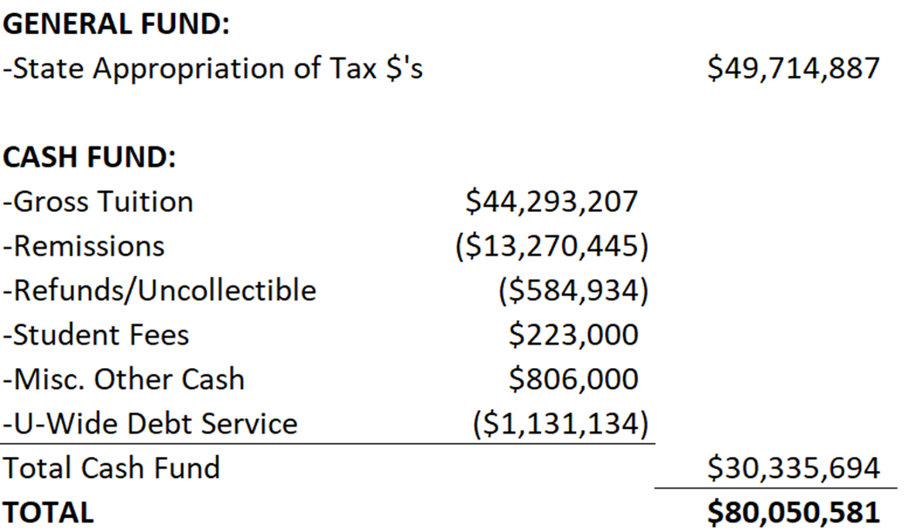
2025-26 State Aided Budget
State and University Generated-Unrestricted and Designated

Slide 10
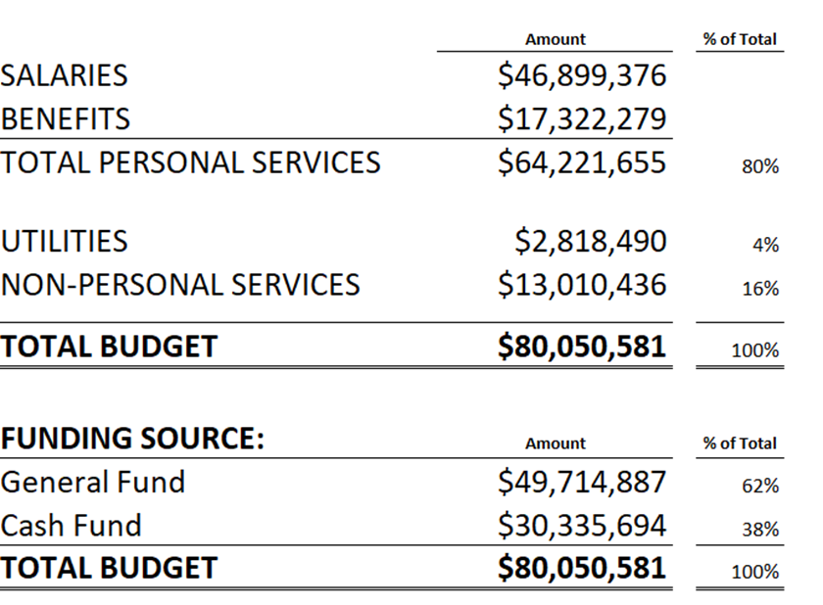
2025-26 State Aided Budget
State and University Generated-Unrestricted and Designated

Slide 11
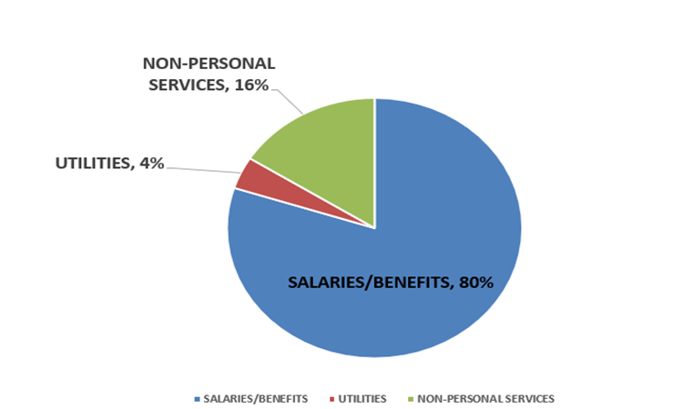
2025-26 State Aided Budget
State and University Generated-Unrestricted and Designated

Slide 12
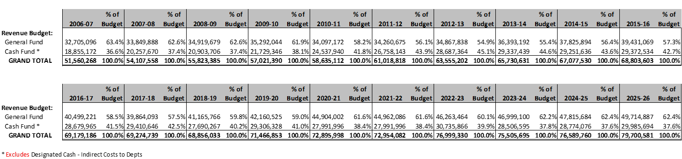
Historical State Aided Budget
State and University Generated-Unrestricted

Slide 13
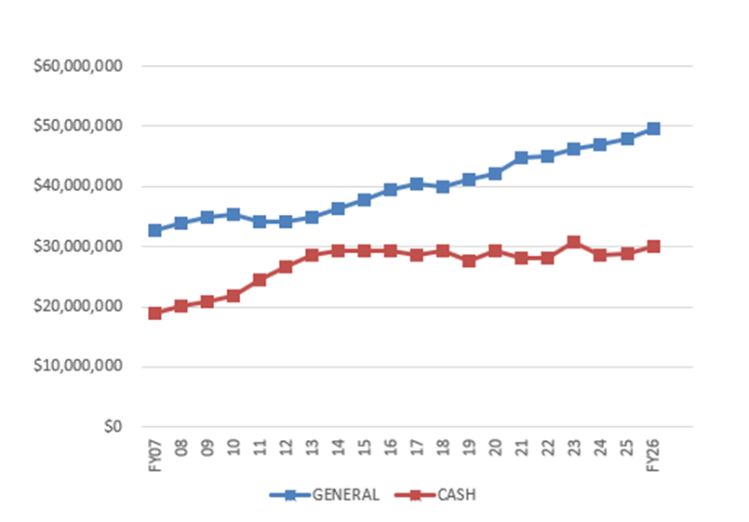
Historical State Aided Budget
State and University Generated-Unrestricted

Slide 14
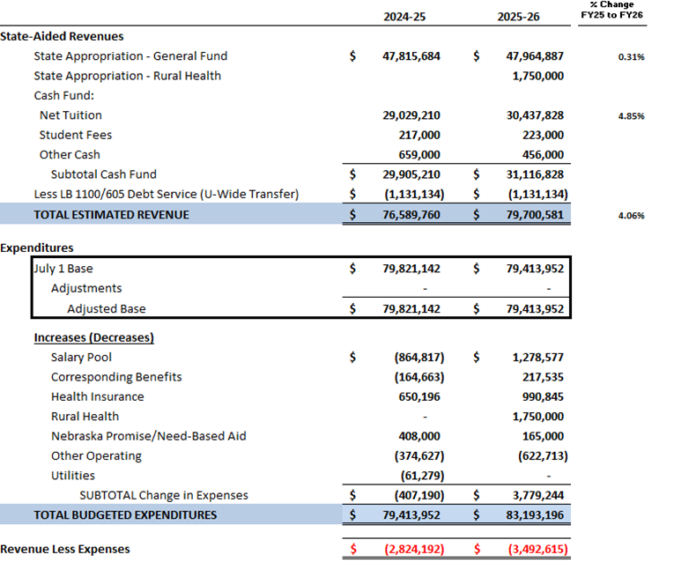
State Aided Budget Allocation Comparison
FY2024-25 to FY2025-26

Slide 15
2025-26 General Operating Budget
State Aided Funds (Non-Revolving)

Slide 16
2025-26 General Operating Budget
State Aided Base Budget by Unit

Slide 17
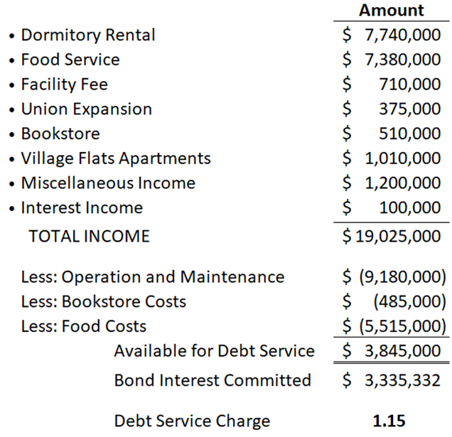
2025-26 Revenue Facilities
Operations and Maintenance Budget

Slide 18
2025-26 Revenue Facilities
Operations and Maintenance Budget by Unit

Slide 19
Submit questions and comments to Interim Vice Chancellor Scott Benson bensonsa1@unk.edu

