Slide 1

Budget Overview
Fiscal Year 2023-24

Slide 2

FUND DEFINITIONS
GENERAL FUND
State tax revenue allocated to the University.
CASH FUNDS
Derived from tuition, fees, investment income, and other miscellaneous income.
FEDERAL FUNDS
Provided by federal agencies for research, grants and contracts, and student aid programs.
REVOLVING FUNDS
Self-generated from departmental sales, charges for housing, food services, etc.
TRUST FUNDS
State and private gifts, grants, and contracts, non-federal student aid programs, etc.

Slide 3
2023-24 Operating Budgets ESTIMATED REVENUE BY FUND SOURCE

Slide 4
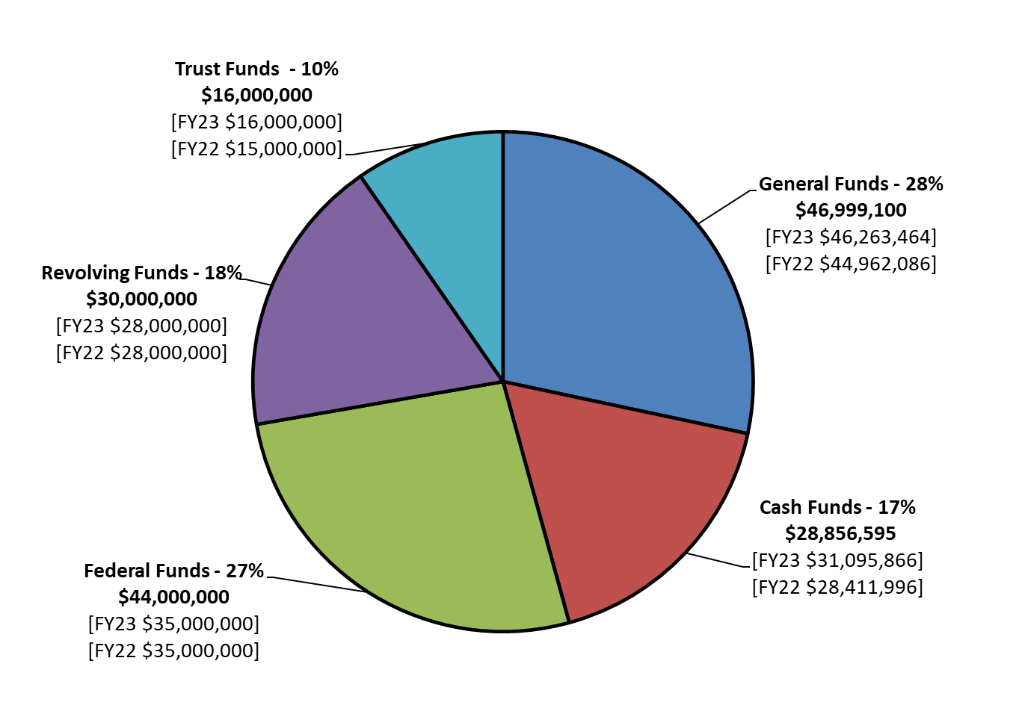
2023-24 Operating Budgets ESTIMATED REVENUE BY FUND SOURCE

Slide 5
Historical Operating Budgets ESTIMATED REVENUE BY FUND SOURCE

Slide 6
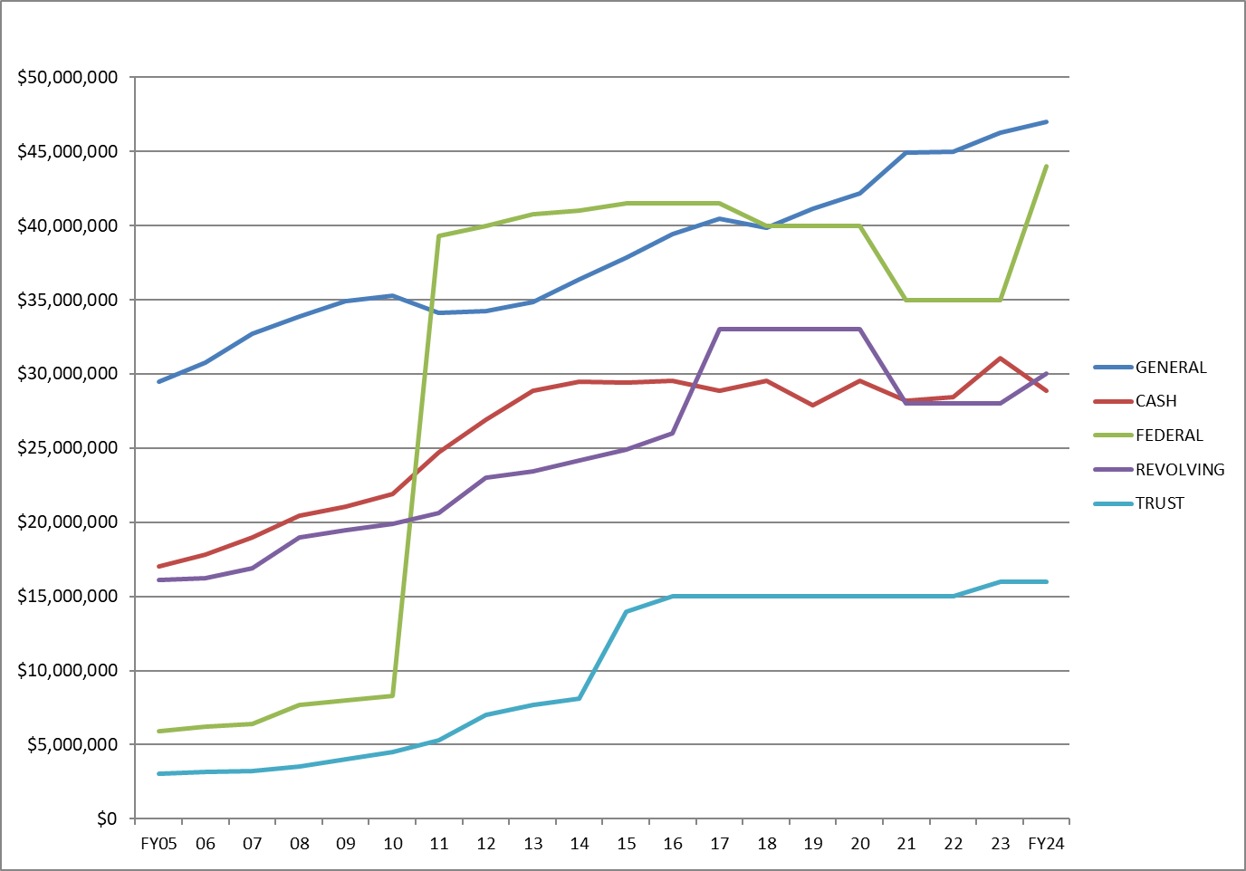
Historical Operating Budgets ESTIMATED REVENUE BY SOURCE

Slide 7
2023-24 Operating Budget Budgeted Expenditures by Spending Category

Slide 8
2023-24 State Aided Budget State and University Generated-Unrestricted & Designated

Slide 9
2023-24 State Aided Budget State and University Generated-Unrestricted

Slide 10
2023-24 State Aided Budget State and University Generated-Unrestricted

Slide 11
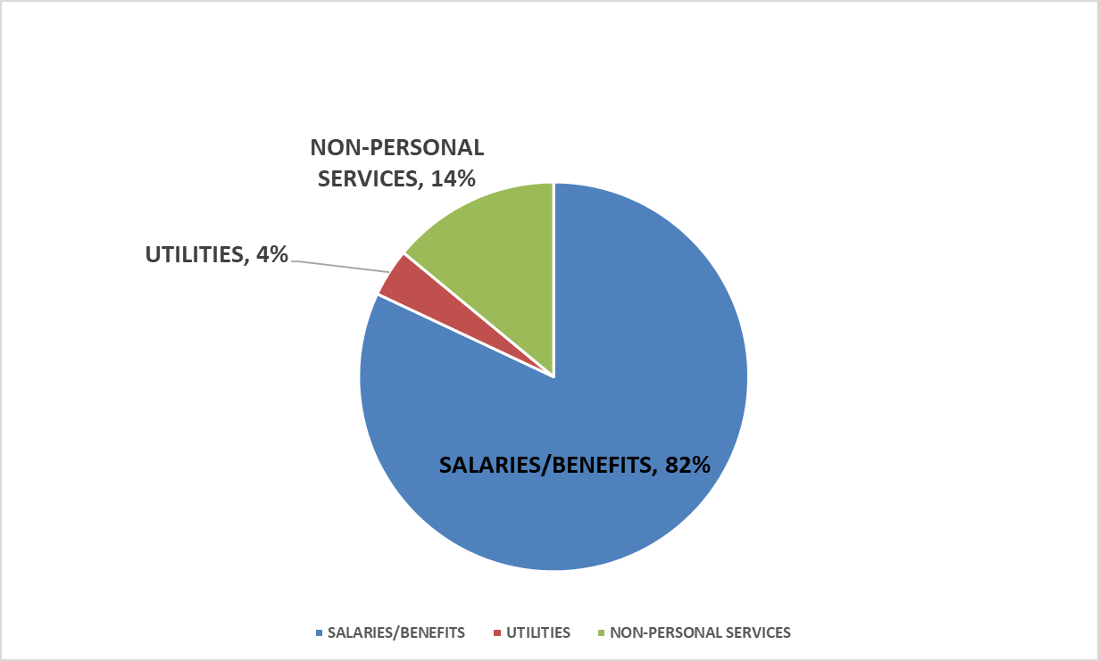
2023-24 State Aided Budget State and University Generated-Unrestricted

Slide 12
Historical State Aided Budget State and University Generated-Unrestricted

Slide 13
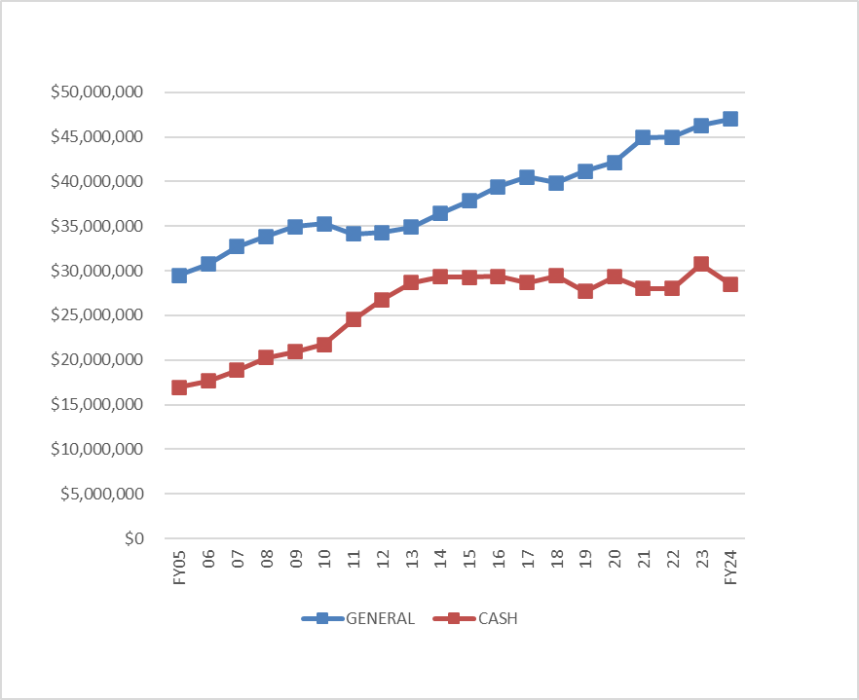
Historical State Aided Budget State and University Generated-Unrestricted

Slide 14
State Aided Budget Allocation Comparison FY23 to FY24

Slide 15
2023-24 General Operating Budget State Aided funds (Non-Revolving)

Slide 16
2023-24 General Operating Budget State Aided base budget by Unit

Slide 17
Revenue Facilities Budget FY2023-24

Slide 18
Revenue Facilities Budget by Unit FY2023-24

Slide 19

Submit questions and comments to
Vice Chancellor Jon C. Watts
wattsjc@unk.edu

