Slide 1
UNIVERSITY OF NEBRASKA AT KEARNEY
BUDGET OVERVIEW
2016-17
Jon C. Watts
Vice Chancellor
Business and Finance
September 2016

Slide 2
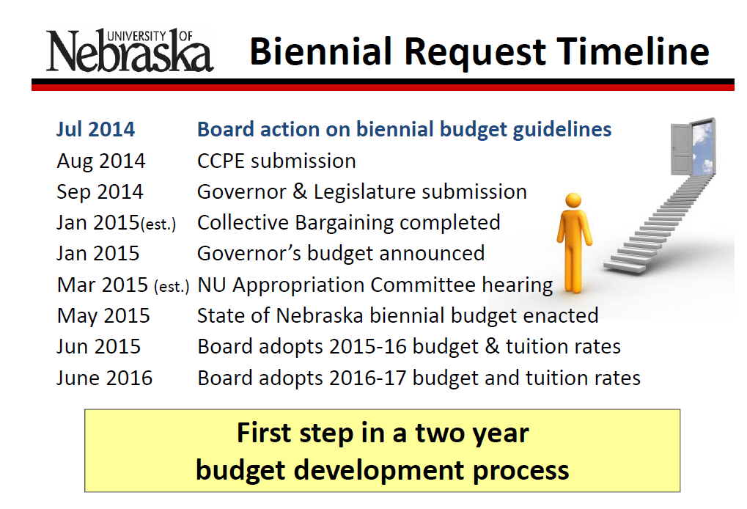

Slide 3
University of Nebraska Hank Bounds
Cornerstones for Success
NU will be the best place in the nation to be a student.
  Affordable and Accessible
  Maintain High Academic Standards
NU will transform lives through research and innovation.
  Targeted Faculty Hires
  Impact Areas: (Water & Agriculture, Early Childhood Education,
  National Security & Defense, Rural Development, Cancer,
  Public Health, Engineering, Information Technology, and
  Arts & Humanities)
NU will work hand-in-hand with partners to achieve shared goals.
  Stable Base of State Support
  Legislative Designations for Strategic Investments in Multi-Campus Initiatives
  Benefit State’s Economy and Quality of Life
  (UNMC Nursing & Allied Health at Kearney)
  NU will win with people.
  Competitive Salaries and Fringe Benefits

Slide 4
University of Nebraska at Kearney
Strategic Plan 2016
Goal 1: Academic Quality. Faculty and staff will ensure ongoing review and continuous improvement of the curriculum across all academic programs on campus.
Goal 2: Access and Success. Increase recruitment and enhance support for student success.
Goal 3: Quality Faculty and Staff. Recruit, support, develop, and retain a high quality and diverse faculty and staff.
Goal 4: Stewardship of Resources. Secure, generate, and responsibly steward the resources necessary to carry out the mission of the campus and ensure long-term institutional fiscal stability and environmental sustainability.

Slide 5
FUND DEFINITIONS
GENERAL FUND
  State tax revenue allocated to the University.
CASH FUNDS
  Derived from tuition, fees, investment income, and other miscellaneous income.
FEDERAL FUNDS
  Provided by federal agencies for research, grants and contracts, and student aid programs.
REVOLVING FUNDS
  Self-generated from departmental sales, charges for housing, food services, etc.
TRUST FUNDS
  State and private gifts, grants, and contracts, non-federal student aid programs, etc.

Slide 9
UNK ALL FUNDS

Slide 11
2016-17 University of Nebraska at Kearney
Budgeted Revenue by Fund Source
Federal Funds | 41,500,000
Revolving Funds | 33,000,000
General Funds | 40,499,221
Trust Funds | 15,000,000
Cash Funds | 28,849,965
Total Estimated Funding | $158,849,186
2016-2017 University of Nebraska at Kearney
Estimated Expenditures by Spending Category
10-Instruction | 45,507,135
20-Research | 1,278,554
30-Public Service | 2,146,324
40-Academic Support | 8,641,680
50-Student Services | 7,004,894
60-Institutional Administration | 9,830,291
70-Physical Plant Operations | 8,493,636
80-Student Financial Support | 43,452,048
90-Independent Operations | 22,917,668
00-Other Non-Expenditures | 9,576,956
Total Budgeted Expenditures | $158,849,186

Slide 12
State Aided Budget
2016-17
(State and University Generated – Unrestricted & Designated)
General Fund $40,499,221
Cash Fund $28,679,965 ___________
TOTAL $69,179,186
Notes:
General Fund: State Appropriation from Tax $’s $34,097,172
Cash Fund: Tuition Gross $32,042,401
Remissions <$6,100,520>
Refunds/Uncollectibles <$1,231,367>
Student Fees $ 249,560
Other Cash $ 709,000
U-Wide Debt Svc <$1,131,134>
TOTAL CASH $24,537,940
TOTAL UNRESTRICTED BUDGET $58,635,112

Slide 13
State Aided Budget
(State & University Generated – Unrestricted)
General Fund:
  State Appropriation of Tax $’s $40,499,221
Cash Funds:
  Gross Tuition $37,780,412
  Remissions ($ 8,040,945)
  Refunds/Uncollect ($ 925,268)
  Student Fees $ 256,900
  Misc Other Cash $ 740,000
  U-Wide Debt Svc ($ 1,131,134) $28,679,965
  TOTAL $69,179,186

Slide 16
UNIVERSITY OF NEBRASKA AT KEARNEY
State Aided Budget

Slide 17
STATE AIDED BUDGET
FY 2016-17
University of Nebraska at Kearney

Slide 21
Current Year Allocation
Personnel/Non-Personnel Base Budget FY17
 | Academic & Student Affairs |  |  | $39,432,991
 |  | Distance Learning - Dept Alloc's |  | $ 1,930,000
 | Business & Finance Division |  |  | $ 9,896,641
 | Chancellor's Division |  |  | $ 3,306,380
 | Campus Enhancement/Priorities |  |  | $ 788,417
 | Benefits |  |  | $13,804,757
 | Indirect Costs Research Incentive |  |  | $ 20,000
 |  | TOTAL |  | $69,179,186

Slide 23
BUDGET REDUCTION HISTORY
2001-02 Special Session ($ 288,246) (FY02)
2001-02 Special Session ($ 592,303) (FY03)
2001-02 April ($ 536,116) (FY03)
2002-03 July 1 ($1,208,572)
2003-04 July 1 ($1,675,828)
2004-05 July 1 ($ 86,335)
2005-06 July 1 ($ 531,021)
2006-07 July 1 $ 0
2007-08 July 1 ($ 243,893)
2008-09 July 1 ($ 385,401)
2009-10 July 1 ($ 794,059)
2009-10 Special Session ($ 342,763)
2010-11 July 1 ($1,086,478)
2011-12 July 1 ($ 368,430)
2012-13 July 1 $ 0
2013-14 July 1 $ 0
2014-15 July 1 $ 0
2015-16 July 1 ($ 176,764)
2015-16 Enrollment/Revenue Decline-Add’l Reduction ($ 988,880)
2016-17 July 1 ($ 241,253)
  TOTAL ($9,546,342)

Slide 24
TUITION INCREASE HISTORY
Tuition
2001-02 10.0%
2002-03 10.0%
2003-04 14.9%
2004-05 12.0%
2005-06 4.9%
2006-07 5.9%
2007-08 6.0%
2008-09 6.0%
2009-10 4.0%
2010-11 6.0%
2011-12 5.0%
2012-13 3.75%
2013-14 0.00% Res; 3% NonRes
2014-15 0.00% Res; 3% NonRes
2015-16 1.75%
2016-17 2.50%

Slide 25
REVENUE BOND BUDGET
(Designated/Restricted)
2016-17
Dormitory Rental $8,139,000
Food Service $7,297,000
Facility Fee $ 680,000
Union Expansion $ 440,000
Bookstore Commission $ 160,000
University Heights Apts $ 290,000
Misc Income $1,089,000
Interest Income $ 160,000
  TOTAL INCOME $ 18,255,000
  LESS OPERATION & MAINTENANCE ($9,018,000)
  LESS FOOD COSTS ($4,778,000)
  Available for Debt Service $4,459,000
  Bond Interest Committed $1,849,290
  Debt Service Charge 2.41

Slide 26
University of Nebraska at Kearney
2016-17 General Operating Budget
REVENUE BOND (Auxiliary/Revolving) |  |  |  |  | FY17 Base Budget
 |  |  | Personal |  | NonPersonal |  | 2016-17 |  | % OF
 |  |  | Services |  | Services |  | BASE BUDGET |  | BASE BUDGET
Unit -benefits separated
Chancellor
Internal Audit-Revenue Bond |  |  | $32,623 |  | $0 |  | $32,623 |  | 0.21%
Intercollegiate Athletics Pre-Season Meals |  |  | $0 |  | $20,000 |  | $20,000 |  | 0.13%
 | Subtotal |  | $32,623 |  | $20,000 |  | $52,623 |  | 0.34%
Academic Affairs
Information Technology Svcs |  |  | $29,774 |  | $244,066 |  | $273,840 |  | 1.75%
Student Affairs (incl Intramurals) |  |  | $1,112,587 |  | $333,287 |  | $1,445,874 |  | 9.24%
 | Subtotal |  | $1,142,361 |  | $577,353 |  | $1,719,714 |  | 10.99%
Business & Finance (Incl Food Svcs & Principle/Interest Payments) |  |  | $2,479,387 |  | $7,954,856 | ** | $10,434,243 |  | 66.69%
Utilities |  |  | $0 |  | $1,693,839 |  | $1,693,839 |  | 10.83%
Benefits |  |  | $1,192,018 |  | $0 |  | $1,192,018 |  | 7.62%
Campus Enhancement/Priority Funds* |  |  | $8,693 |  | $544,160 |  | $552,853 |  | 3.53%
TOTAL BASE BUDGET |  |  | $4,855,082 |  | $10,790,208 |  | $15,645,290 |  | 100.00%
* Funding accumulation will be used for future revenue bond projects.
** Food Svc Exp's $4,778,000; Principle/Interest Payments $1,849,290

Slide 27
ROOM & BOARD INCREASE HISTORY
ROOM/Sem BOARD/Sem Per Year
2001-02 $1,008 +$88 $ 943 +$53 $3,902
2002-03 $1,071 +$63 $1,007 +$64 $4,156
2003-04 $1,146 +$75 $1,072 +$65 $4,436
2004-05 $1,289 +$143 $1,206 +$134 $4,990
2005-06 $1,376 +$87 $1,287 +$81 $5,326
2006-07 $1,469 +$93 $1,374 +$87 $5,686
2007-08 $1,550 +$81 $1,450 +$76 $6,000
2008-09 $1,635 +$85 $1,530 +$80 $6,330
2009-10 $1,725 +$90 $1,690 +$160 $6,830
2010-11 $1,820 +$95 $1,783 +$93 $7,206
2011-12 $1,911 +$91 $1,868 +$85 $7,558
2012-13 $2,007 +$96 $1,962 +$94 $7,938
2013-14 $2,107 +$100 $2,060 +$98 $8,434
2014-15 $2,212 +$105 $2,163 +$103 $8,880
2015-16 $2,300 +$88 $2,250 +$87 $9,230
2016-17 $2,392 +$92 $2,340 +$90 $9,594
Notes:
Room: Double
Board: FY11 21 meal 7-day +80 pts

Slide 28
QUESTIONS OR COMMENTS SHOULD BE SUBMITTED TO VICE CHANCELLOR Jon C. Watts
AT Wattsjc@UNK.EDU

